Slide 1
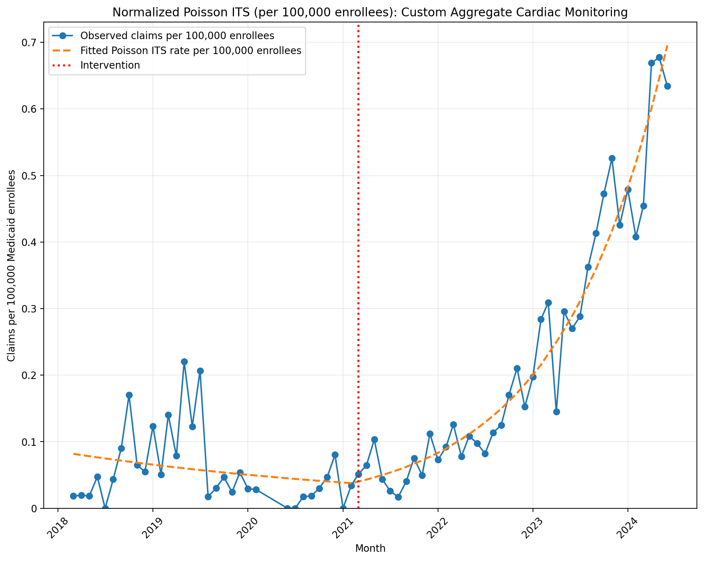
Normalized Poisson ITS (per 100,000 enrollees): Custom Aggregate Cardiac Monitoring
Generalized Linear Model Regression Results
==============================================================================
Dep. Variable: y No. Observations: 73
Model: GLM Df Residuals: 69
Model Family: Poisson Df Model: 3
Link Function: Log Scale: 1.0000
Method: IRLS Log-Likelihood: -1016.9
Date: Sun, 17 May 2026 Deviance: 1601.9
Time: 22:52:17 Pearson chi2: 1.70e+03
No. Iterations: 5 Pseudo R-squ. (CS): 1.000
Covariance Type: nonrobust
==============================================================================
coef std err z P>|z| [0.025 0.975]
------------------------------------------------------------------------------
const -14.0178 0.045 -310.654 0.000 -14.106 -13.929
T -0.0221 0.003 -8.793 0.000 -0.027 -0.017
X_t -0.0145 0.067 -0.217 0.828 -0.146 0.117
post_time 0.0953 0.003 34.558 0.000 0.090 0.101
==============================================================================
Codes in aggregation: 0295T, 93241, 93245

Slide 2
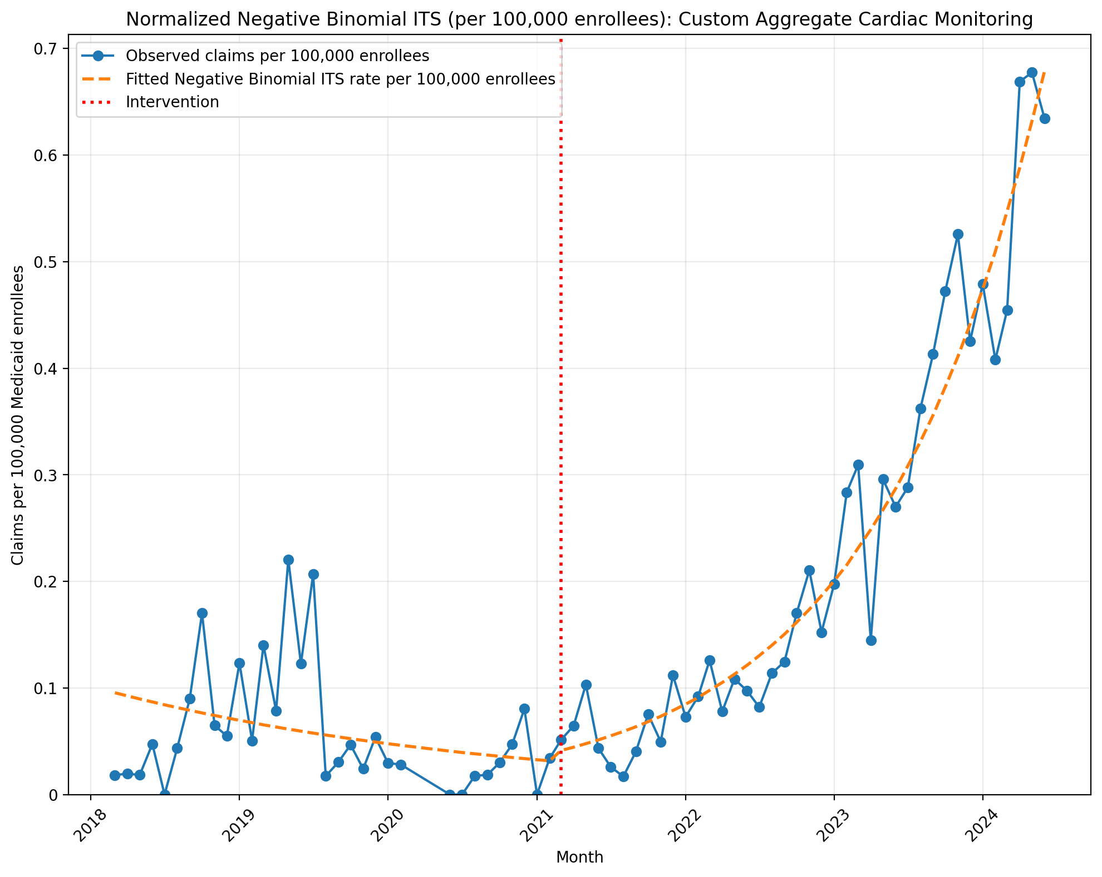
Normalized Negative Binomial ITS (per 100,000 enrollees): Custom Aggregate Cardiac Monitoring
NegativeBinomial Regression Results
==============================================================================
Dep. Variable: y No. Observations: 73
Model: NegativeBinomial Df Residuals: 69
Method: MLE Df Model: 3
Date: Sun, 17 May 2026 Pseudo R-squ.: 0.08133
Time: 22:52:17 Log-Likelihood: -393.39
converged: True LL-Null: -428.22
Covariance Type: nonrobust LLR p-value: 5.068e-15
==============================================================================
coef std err z P>|z| [0.025 0.975]
------------------------------------------------------------------------------
const -13.8615 0.266 -52.169 0.000 -14.382 -13.341
T -0.0316 0.014 -2.258 0.024 -0.059 -0.004
X_t 0.1959 0.366 0.535 0.592 -0.521 0.913
post_time 0.1033 0.017 6.086 0.000 0.070 0.137
alpha 0.5044 0.090 5.582 0.000 0.327 0.681
==============================================================================
Codes in aggregation: 0295T, 93241, 93245

Slide 3
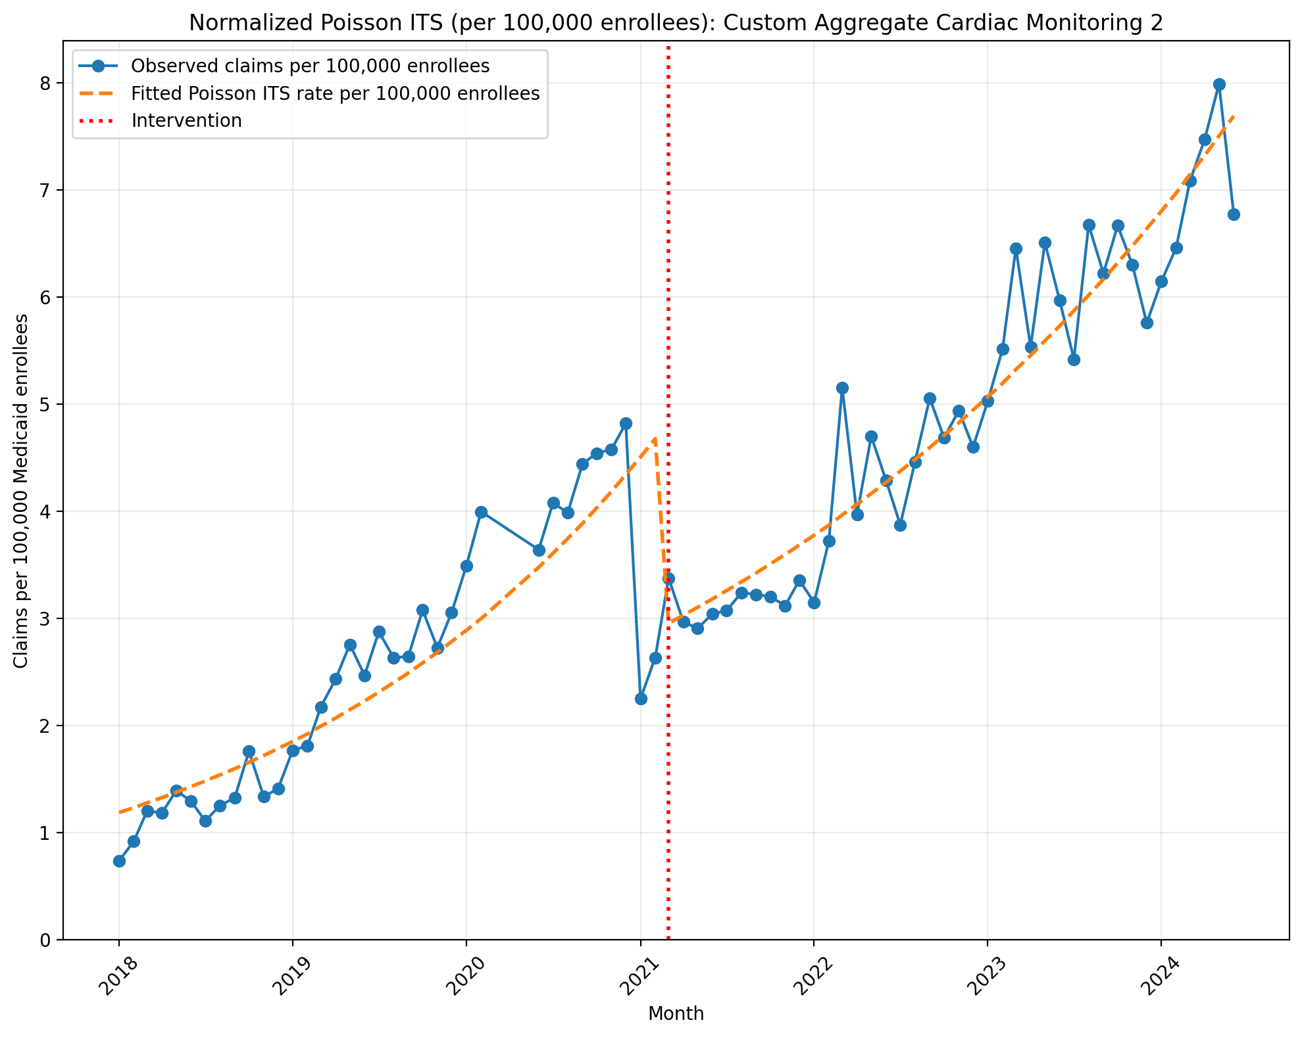
Normalized Poisson ITS (per 100,000 enrollees): Custom Aggregate Cardiac Monitoring 2
Generalized Linear Model Regression Results
==============================================================================
Dep. Variable: y No. Observations: 75
Model: GLM Df Residuals: 71
Model Family: Poisson Df Model: 3
Link Function: Log Scale: 1.0000
Method: IRLS Log-Likelihood: -2995.0
Date: Sun, 17 May 2026 Deviance: 5255.9
Time: 22:53:31 Pearson chi2: 4.95e+03
No. Iterations: 5 Pseudo R-squ. (CS): 1.000
Covariance Type: nonrobust
==============================================================================
coef std err z P>|z| [0.025 0.975]
------------------------------------------------------------------------------
const -11.3429 0.009 -1288.092 0.000 -11.360 -11.326
T 0.0371 0.000 106.496 0.000 0.036 0.038
X_t -0.4838 0.008 -58.051 0.000 -0.500 -0.468
post_time -0.0126 0.000 -30.854 0.000 -0.013 -0.012
==============================================================================
Codes in aggregation: 0295T, 0297T, 93241, 93243, 93245

Slide 4
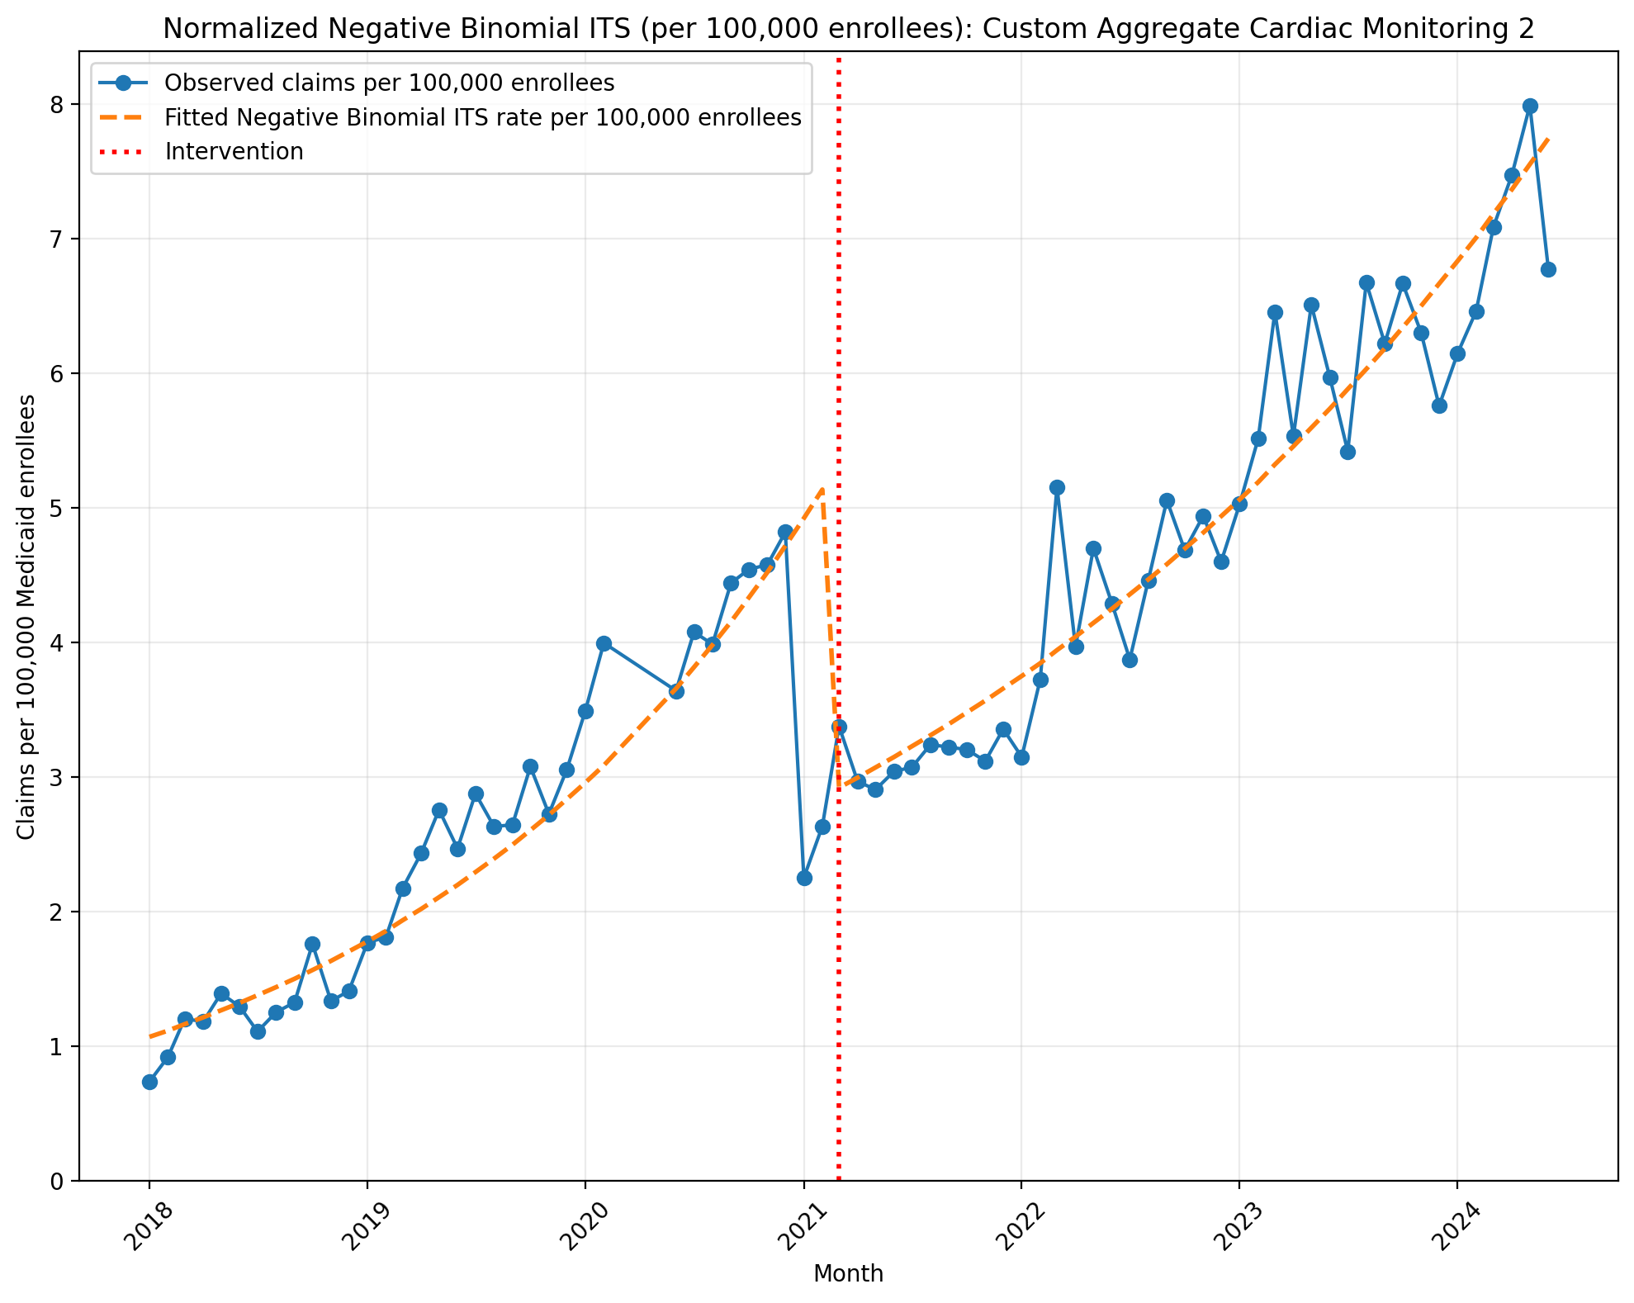
Normalized Negative Binomial ITS (per 100,000 enrollees): Custom Aggregate Cardiac Monitoring 2
NegativeBinomial Regression Results
==============================================================================
Dep. Variable: y No. Observations: 75
Model: NegativeBinomial Df Residuals: 71
Method: MLE Df Model: 3
Date: Sun, 17 May 2026 Pseudo R-squ.: 0.1382
Time: 22:53:31 Log-Likelihood: -564.97
converged: False LL-Null: -655.60
Covariance Type: nonrobust LLR p-value: 4.698e-39
==============================================================================
coef std err z P>|z| [0.025 0.975]
------------------------------------------------------------------------------
const -11.4478 0.053 -215.171 0.000 -11.552 -11.344
T 0.0425 0.003 16.552 0.000 0.037 0.047
X_t -0.5896 0.076 -7.759 0.000 -0.739 -0.441
post_time -0.0174 0.003 -5.175 0.000 -0.024 -0.011
alpha 0.0248 0.004 6.035 0.000 0.017 0.033
==============================================================================
Codes in aggregation: 0295T, 0297T, 93241, 93243, 93245

Slide 5
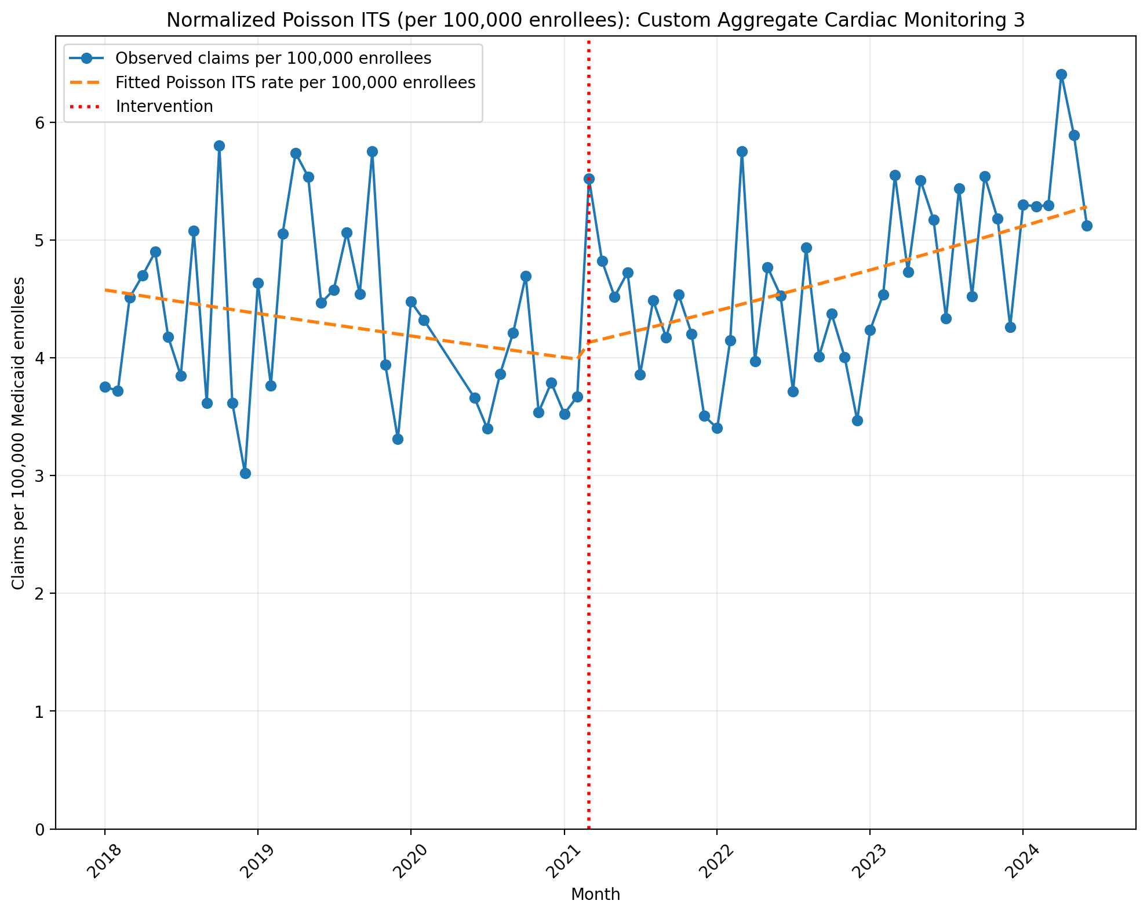
Normalized Poisson ITS (per 100,000 enrollees): Custom Aggregate Cardiac Monitoring 3
Generalized Linear Model Regression Results
==============================================================================
Dep. Variable: y No. Observations: 75
Model: GLM Df Residuals: 71
Model Family: Poisson Df Model: 3
Link Function: Log Scale: 1.0000
Method: IRLS Log-Likelihood: -3450.4
Date: Sun, 17 May 2026 Deviance: 6145.0
Time: 22:54:24 Pearson chi2: 6.20e+03
No. Iterations: 4 Pseudo R-squ. (CS): 1.000
Covariance Type: nonrobust
==============================================================================
coef std err z P>|z| [0.025 0.975]
------------------------------------------------------------------------------
const -9.9922 0.005 -1830.531 0.000 -10.003 -9.982
T -0.0037 0.000 -14.223 0.000 -0.004 -0.003
X_t 0.0289 0.008 3.714 0.000 0.014 0.044
post_time 0.0100 0.000 29.759 0.000 0.009 0.011
==============================================================================
Codes in aggregation: 0295T, 93224, 93241, 93245

Slide 6
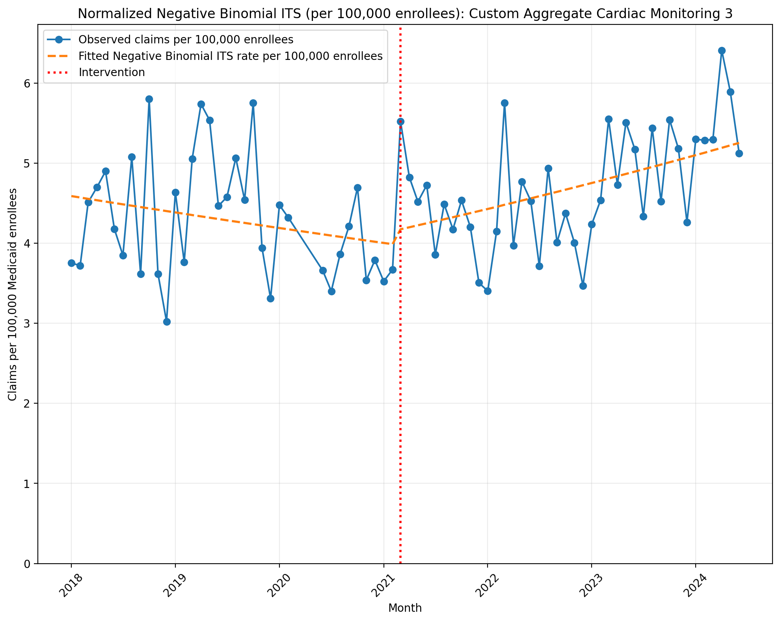
Normalized Negative Binomial ITS (per 100,000 enrollees): Custom Aggregate Cardiac Monitoring 3
NegativeBinomial Regression Results
==============================================================================
Dep. Variable: y No. Observations: 75
Model: NegativeBinomial Df Residuals: 71
Method: MLE Df Model: 3
Date: Sun, 17 May 2026 Pseudo R-squ.: 0.01388
Time: 22:54:24 Log-Likelihood: -581.52
converged: True LL-Null: -589.71
Covariance Type: nonrobust LLR p-value: 0.0009533
==============================================================================
coef std err z P>|z| [0.025 0.975]
------------------------------------------------------------------------------
const -9.9895 0.048 -207.152 0.000 -10.084 -9.895
T -0.0038 0.002 -1.634 0.102 -0.008 0.001
X_t 0.0397 0.069 0.573 0.567 -0.096 0.176
post_time 0.0097 0.003 3.177 0.001 0.004 0.016
alpha 0.0217 0.004 6.069 0.000 0.015 0.029
==============================================================================
Codes in aggregation: 0295T, 93224, 93241, 93245

Slide 7
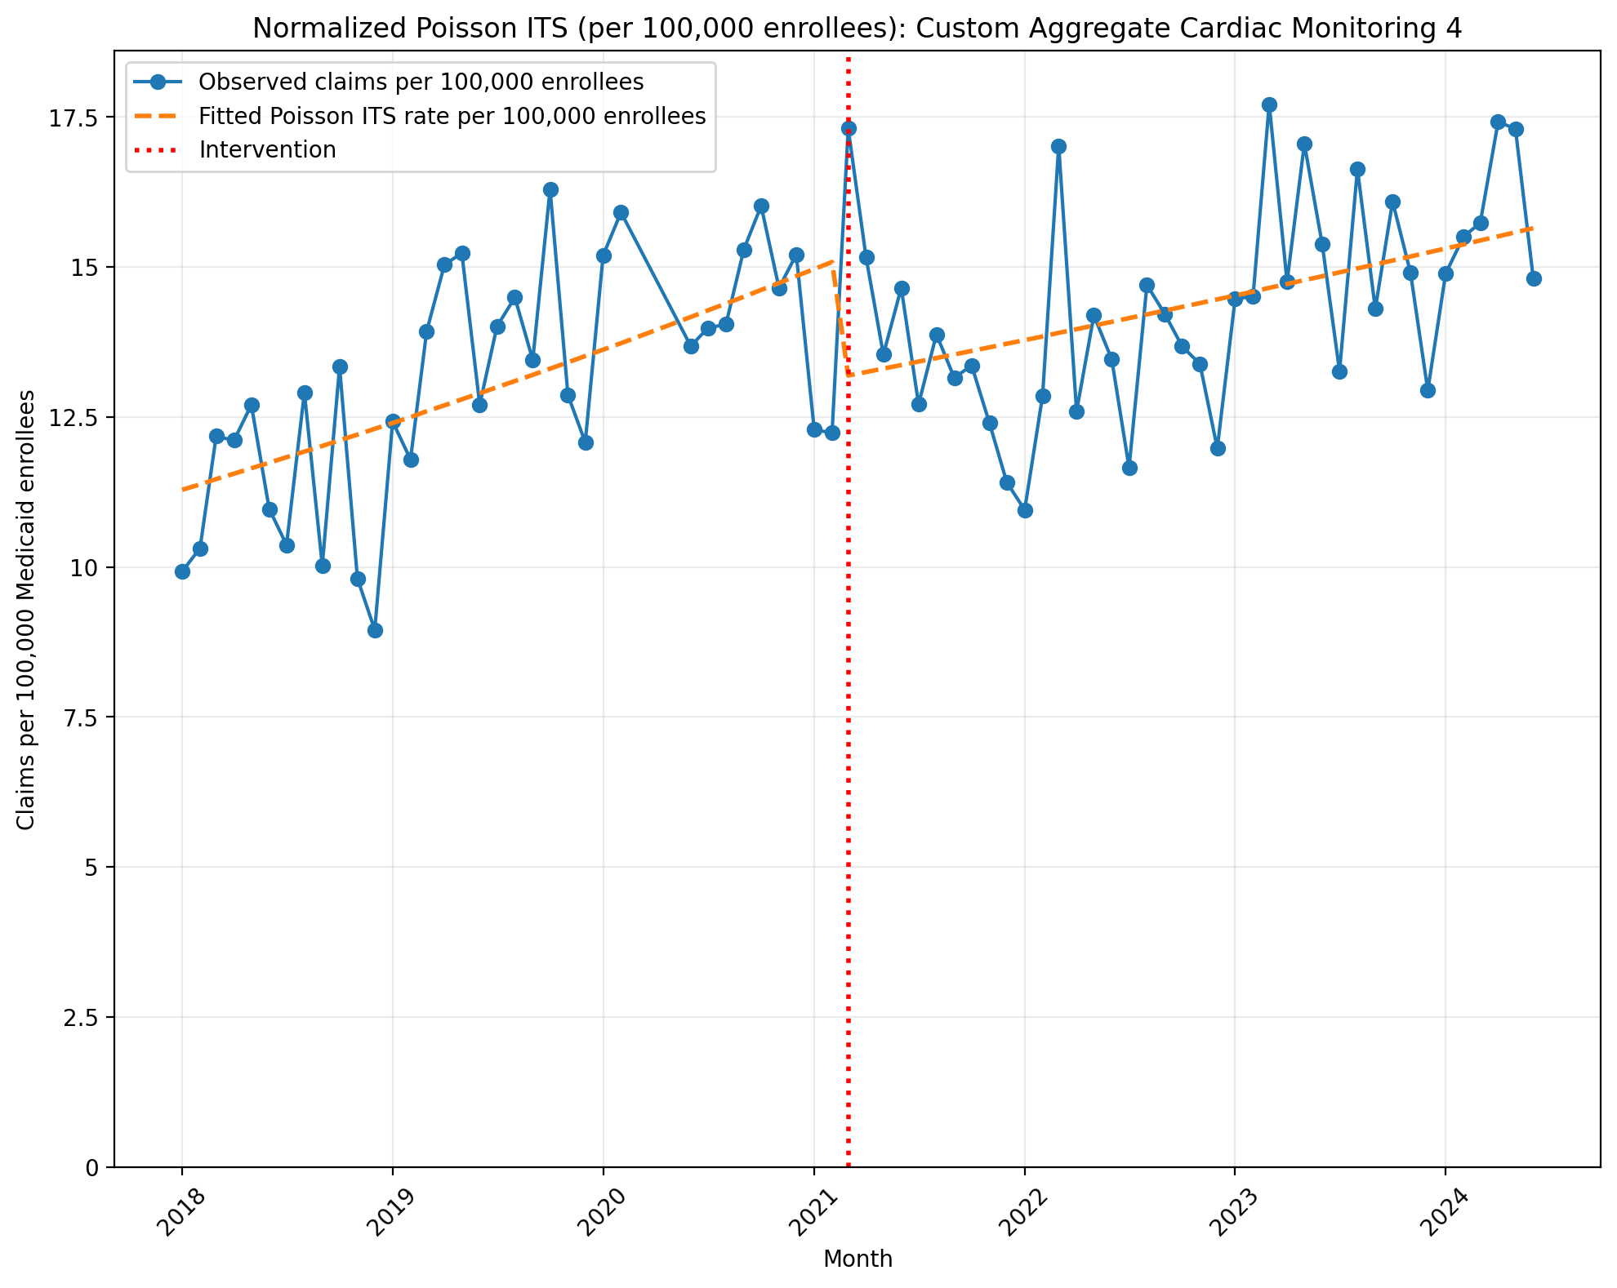
Normalized Poisson ITS (per 100,000 enrollees): Custom Aggregate Cardiac Monitoring 4
Generalized Linear Model Regression Results
==============================================================================
Dep. Variable: y No. Observations: 75
Model: GLM Df Residuals: 71
Model Family: Poisson Df Model: 3
Link Function: Log Scale: 1.0000
Method: IRLS Log-Likelihood: -6193.4
Date: Sun, 17 May 2026 Deviance: 11547.
Time: 22:55:11 Pearson chi2: 1.15e+04
No. Iterations: 4 Pseudo R-squ. (CS): 1.000
Covariance Type: nonrobust
==============================================================================
coef std err z P>|z| [0.025 0.975]
------------------------------------------------------------------------------
const -9.0893 0.003 -2755.460 0.000 -9.096 -9.083
T 0.0078 0.000 52.759 0.000 0.008 0.008
X_t -0.1385 0.004 -32.352 0.000 -0.147 -0.130
post_time -0.0035 0.000 -18.063 0.000 -0.004 -0.003
==============================================================================
Codes in aggregation: 93224, 93226, 0295T, 0297T, 93241, 93243, 93245

Slide 8
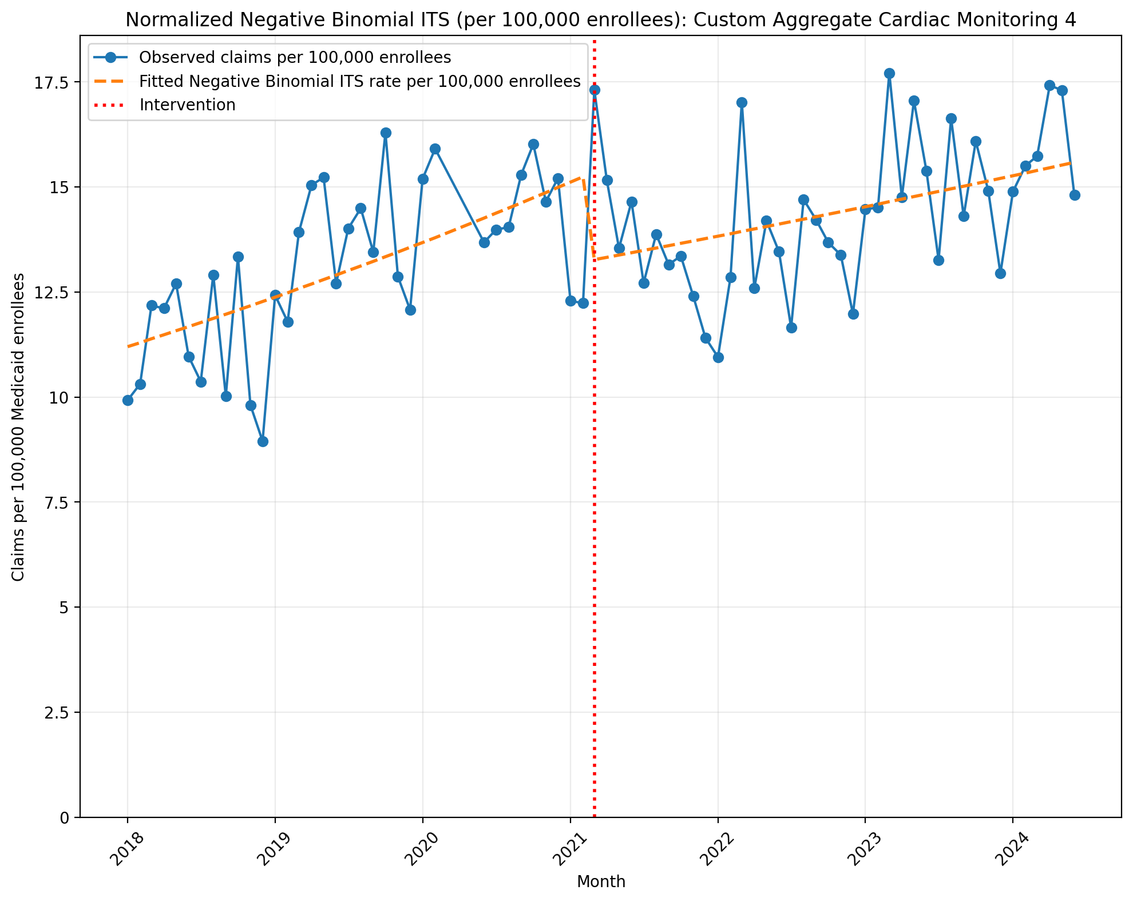
Normalized Negative Binomial ITS (per 100,000 enrollees): Custom Aggregate Cardiac Monitoring 4
NegativeBinomial Regression Results
==============================================================================
Dep. Variable: y No. Observations: 75
Model: NegativeBinomial Df Residuals: 71
Method: MLE Df Model: 3
Date: Sun, 17 May 2026 Pseudo R-squ.: 0.02523
Time: 22:55:11 Log-Likelihood: -646.92
converged: False LL-Null: -663.67
Covariance Type: nonrobust LLR p-value: 2.542e-07
==============================================================================
coef std err z P>|z| [0.025 0.975]
------------------------------------------------------------------------------
const -9.0970 0.037 -242.795 0.000 -9.170 -9.024
T 0.0083 0.002 4.638 0.000 0.005 0.012
X_t -0.1427 0.054 -2.633 0.008 -0.249 -0.036
post_time -0.0042 0.002 -1.768 0.077 -0.009 0.000
alpha 0.0133 0.002 6.096 0.000 0.009 0.018
==============================================================================
Codes in aggregation: 93224, 93226, 0295T, 0297T, 93241, 93243, 93245

